Slide 1
Intro to
Data Science

Slide 2

Learning Objectives & Agenda

Slide 3

Learning objectives
Be able to
Describe data science and explain its different facets
Explain the differences between statistics and machine learning
Explain the major branches of machine learning and the types of problems they solve
Describe special topics within data science

Slide 4
Agenda
A Brief History of Data Science
Basics of Data Science
Analytics and Statistics
Statistics and Machine Learning
Machine Learning and Artificial Intelligence
Special Topics
Notes:
2

Slide 5
A BRIEF HISTORY OF DATA SCIENCE

Slide 6
History
In 2008, Jeff Hammerbacher at Facebook and DJ Patil at Linkedin needed a new title to describe the growing responsibilities of their data and analytics teams: ”Data Scientist” was born
”Data Science”, as a term, has been around much longer
Notes:
http://radar.oreilly.com/2011/09/building-data-science-teams.html
https://www.forbes.com/sites/gilpress/2013/05/28/a-very-short-history-of-data-science/#5391e47b55cf

Slide 7
History
Data science rose to prominence circa 2012, when DJ Patil and Thomas H. Davenport wrote “Data Scientists: Sexiest Job of the 21st Century” for Harvard Business Review
Notes:
http://radar.oreilly.com/2011/09/building-data-science-teams.html
https://www.forbes.com/sites/gilpress/2013/05/28/a-very-short-history-of-data-science/#5391e47b55cf

Slide 8
Definition
Data science is the practice of extracting useful and actionable information from data that is used to create value
This is achieved through a combination of analysis, statistics, machine learning, artificial intelligence, and programming
With these tools, we can use computers to answer questions and achieve results that were previously not possible

Slide 9
BASICS OF DATA SCIENCE

Slide 10
Ambiguity
The details of what qualifies as data science are still up for dispute
The field is young, so its boundaries are naturally soft
”Data Science” is now often used as a catchall term for advanced analytics

Slide 11
Ambiguity
Different organizations use the term “data science” and “data scientist” to refer to vastly different functions and roles:
Product Analytics
Research and development
Statistics
And many others

Slide 12
Ambiguity
Data science generally includes some combination of analysis, statistics, machine learning, artificial intelligence, and programming
Typical languages used by data scientists include Python, SQL, R

Slide 13
Major Components
Analytics: the discovery of patterns in data and their application to decision making
Statistics: branch of mathematics focusing on uncovering meaning in data and randomness

Slide 14

Major Components
Machine Learning: the study of algorithms and statistical models to improve task performance
Computer Science: the study of algorithms and computation
Artificial Intelligence (AI): No agreed upon definition

Slide 15
Major Components
There is no hard cut line between any of these components
They cannot stand independent of each other

Slide 16
Problem Types
Descriptive: What did happen?
Mean, median, distribution, max
Predictive: What will (likely) happen?
Stock price prediction, estimated probability of churn
Prescriptive: What should we do?
Pricing, resource allocation
℞

Slide 17
Problem Types
Relationships: If one variable changes, is this other variable likely to?
Correlation, linear coefficients, “links”
Organization: Is there natural structure to the data? Clear groups?
Clustering, dimension reduction, customer segmentation

Slide 18
Problem Types
Identification: Can we identify unknown values?
Classification, sentiment analysis
Anomalies: Where are the strange data points?
Anomaly detection, outliers

Slide 19
Data Science Team Skills
To be successful, data science teams need a variety of skills
Comms/
Storytelling
Modeling
Data Munging
Communicate with business leaders
Integrate code into backend software systems
Domain Expertise
Statistics
Software Engineering

Slide 20
Data Science Team Roles
To support the needed skills and achieve impact, data science teams need a diverse set of roles
Product Manager
Machine Learning Engineer
Data Engineer
Communicate with business leaders
Integrate code into backend software systems
Business Analyst
Statistician
Research Scientist
Software Engineering

Slide 21
Data Science Project Workflow
Data science projects have predictable steps, but iterate on and revisit them often
Problem Statement
What problem are you trying to solve?
Data Collection
What data do you need to solve it?
Data Exploration & Preprocessing
Do you understand your data? Will your model?
Modeling
Build a model to solve your problem
Validation
Did I solve the problem?
Decision Making & Deployment
Communicate to stakeholders or put into production

Slide 22
ANALYTICS & STATISTICS

Slide 23
Analytics
Answers direct, clear questions with deterministic answers
Monitors changes in business and informs decision makers
Leans heavily on business rules
Notes:
2

Slide 24
Analytics
Often specializing in one branch of business, e.g. product analytics, financial analytics, marketing analytics
Combine some level of subject matter expertise (SME) with data know-how
Tools: SQL, Excel, Tableau
Notes:
2

Slide 25
Analytics
Most commonly answer descriptive questions
Sometimes answers predictive questions
Results inform decision makers to help prescribe action
Notes:
2

Slide 26
Statistics
A field of mathematics dedicated to interpreting patterns in data and making inference about them
Two major branches, frequentist (standard) and Bayesian (new & exciting)
Specialized subfields, e.g. time series analysis, experimental design
”Backbone” of modern science
Notes:
2

Slide 27
Statistics
High overlap with other fields, e.g. operations research, applied math, computer science, econometrics, etc.
Methods include: regression, generalized linear models, p-values
Tools: R, SAS
Notes:
2

Slide 28
Statistics
Answers descriptive, predictive, and relationship questions
Probability and mathematical guarantees
Concerned with the distribution of numbers & metrics
Notes:
2

Slide 29
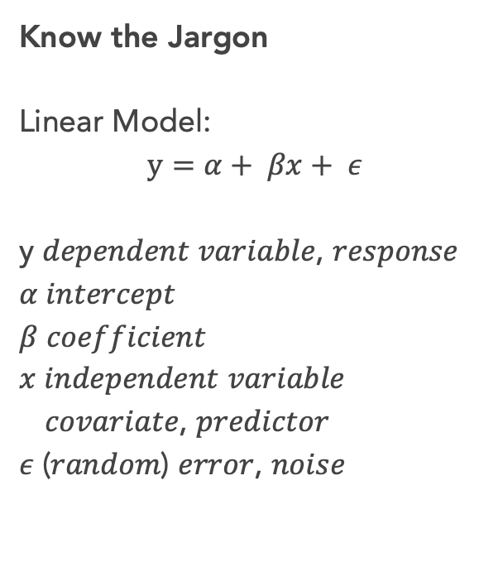
Know the Jargon
Linear Model:
$$y=α+ βx+ ε$$
y 𝑑𝑒𝑝𝑒𝑛𝑑𝑒𝑛𝑡 𝑣𝑎𝑟𝑖𝑎𝑏𝑙𝑒, 𝑟𝑒𝑠𝑝𝑜𝑛𝑠𝑒
𝛼 𝑖𝑛𝑡𝑒𝑟𝑐𝑒𝑝𝑡
𝛽 𝑐𝑜𝑒𝑓𝑓𝑖𝑐𝑖𝑒𝑛𝑡
𝑥 𝑖𝑛𝑑𝑒𝑝𝑒𝑛𝑑𝑒𝑛𝑡 𝑣𝑎𝑟𝑖𝑎𝑏𝑙𝑒
𝑐𝑜𝑣𝑎𝑟𝑖𝑎𝑡𝑒, 𝑝𝑟𝑒𝑑𝑖𝑐𝑡𝑜𝑟
𝜖 (𝑟𝑎𝑛𝑑𝑜𝑚) 𝑒𝑟𝑟𝑜𝑟, 𝑛𝑜𝑖𝑠𝑒

Slide 30
STATISTICS & MACHINE LEARNING

Slide 31
A Word to Statisticians
Rather notoriously, the line between statistics and machine learning is blurry
And, statistics came first

Slide 32
A Word to Statisticians
Statistics emphasizes
formal statistical inference (confidence intervals, hypothesis tests, optimal estimators) in low dimensional problems.
Machine Learning emphasizes
high dimensional prediction problems.
“But this is a gross over-simplification.”
Statistics pays more attention to
survival analysis, spatial analysis, multiple testing, minimax theory, deconvolution, semiparametric inference, bootstrapping, time series.
Machine Learning pays more attention to
online learning, semisupervised learning, manifold learning, active learning, boosting
“But the differences become blurrier all the time.”
from Larry A. Wasserman
author of All of Statistics
Notes:
https://normaldeviate.wordpress.com/2012/06/12/statistics-versus-machine-learning-5-2/

Slide 33
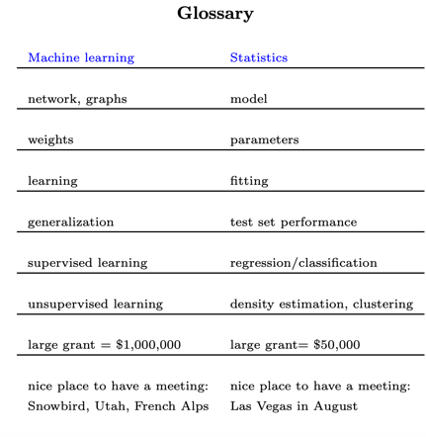
A Word to Statisticians
Machine learning is “glorified statistics”
from Robert Tibshirani
coauthor of Elements of Statistical Learning
Notes:
The ”machine learning ‘bible’”
https://www.kdnuggets.com/2016/11/machine-learning-vs-statistics.html
http://statweb.stanford.edu/~tibs/stat315a/glossary.pdf

Slide 34
A Word to Statisticians
from u/keymado
redditor on r/datascience

Slide 35
A Word to Statisticians
The concepts are often familiar, although the words are sometimes different
Data science leans towards ML jargon, but both are used

Slide 36
A Word to Statisticians
& Computer Scientists, Mathematicians, Data Scientists, Physicists, Social Scientists, Engineers…..
We have many words for the same thing
And sometimes, we have the same word for many things 🤷‍♀️
Notes:
Features, predictors, independent variables
Model—mathematical model, computer model, data science model
Entropy, in physics v information theory

Slide 37
MACHINE LEARNING & ARTIFICIAL INTELLIGENCE

Slide 38
Machine Learning (ML)
Machine learning allows computers to learn and infer from data
These programs learn from repeatedly seeing data, rather than being explicitly programmed by humans
SPAM?
Machine Learning Program
NOT SPAM?
Emails are labeled as spam vs. not
The more emails the program sees…
…the better it gets at
classification

Slide 39
Machine Learning (ML)
Algorithms and statistical models that enable computers to uncover patterns in data
High overlap with statistics; some classic statistical models are also referred to as machine learning models, e.g. linear regression
Two main branches of algorithms: supervised and unsupervised
Notes:
2

Slide 40
Artificial Intelligence (AI)
No agreed upon definition
May refer to anything from machine learning to self-driving cars to Ex Machina’s Ava
It’s not magic--it’s just math
AI effect: "AI is whatever hasn't been done yet." ~ Douglas Hofstadter
Notes:
2

Slide 41

Know the Jargon
ML Model:
$$y \sim x$$
y $target, label, output$
𝑥 $features, input$

Slide 42
Machine Learning
Machine Learning
Supervised Learning
Unsupervised Learning
Regression
Classification
Clustering
Dimension Reduction
Demand forecasting
Lifetime value
Churn
Fraud
Customer Segmentation
Feature generation
Image Compression
Feature generation

Slide 43
Supervised Learning
Supervised Learning
Machine learning with labels
Label: also known as target, y, output, class
Two major flavors: regression and classification
Notes:
2

Slide 44
Machine Learning
Machine Learning
Supervised Learning
Unsupervised Learning
Regression
Classification
Clustering
Dimension Reduction
Demand forecasting
Lifetime value
Churn
Fraud
Customer Segmentation
Feature generation
Image Compression
Feature generation

Slide 45
Supervised Learning: Regression
Labels are numbers, e.g. 74.2, .00053, 32.0
Linear and nonlinear models
Algorithms include linear regression, SVMs, random forests
Notes:
2

Slide 46
Supervised Learning: Regression
Answer questions like:
How much profit will we make next year?
How long will a reader stay on our site?
Applications: demand forecasting, predicting stock prices, customer lifetime value
Notes:
2

Slide 47
Machine Learning
Machine Learning
Supervised Learning
Unsupervised Learning
Regression
Classification
Clustering
Dimension Reduction
Demand forecasting
Lifetime value
Churn
Fraud
Customer Segmentation
Feature generation
Image Compression
Feature generation

Slide 48
Machine Learning
Machine Learning
Supervised Learning
Unsupervised Learning
Regression
Classification
Clustering
Dimension Reduction
Demand forecasting
Lifetime value
Churn
Fraud
Customer Segmentation
Feature generation
Image Compression
Feature generation

Slide 49
Supervised Learning: Classification
Labels are class or group, e.g. 1 or 0, “churned” or “not churned”
Linear and nonlinear models
Algorithms include k-nearest neighbors, logistic regression, decision trees, SVMs
Notes:
2

Slide 50
Supervised Learning: Classification
Answer questions like:
Is this a preferred member?
Is this purchase fraudulent?
Applications: churn modelling, fraud detection
Notes:
2

Slide 51
Machine Learning
Machine Learning
Supervised Learning
Unsupervised Learning
Regression
Classification
Clustering
Dimension Reduction
Demand forecasting
Lifetime value
Churn
Fraud
Customer Segmentation
Feature generation
Image Compression
Feature generation

Slide 52
Machine Learning
Machine Learning
Supervised Learning
Unsupervised Learning
Regression
Classification
Clustering
Dimension Reduction
Demand forecasting
Lifetime value
Churn
Fraud
Customer Segmentation
Feature generation
Image Compression
Feature generation

Slide 53
Unsupervised Learning
Unsupervised Learning
Machine learning without labels
Uncover the underlying structure of data
Two major branches: clustering and dimension reduction
Notes:
2

Slide 54
Machine Learning
Machine Learning
Supervised Learning
Unsupervised Learning
Regression
Classification
Clustering
Dimension Reduction
Demand forecasting
Lifetime value
Churn
Fraud
Customer Segmentation
Feature generation
Image Compression
Feature generation

Slide 55
Unsupervised Learning: Clustering
Goal is to uncover naturally occurring groups within the data
Algorithms include k-means, hierarchical agglomerative clustering, DBSCAN
Notes:
2

Slide 56
Unsupervised Learning: Clustering
Answer questions like:
Do we have groups of similar drivers?
Can we organize our archives into similar articles?
Applications: customer segmentation, feature generation
Notes:
2

Slide 57
Machine Learning
Machine Learning
Supervised Learning
Unsupervised Learning
Regression
Classification
Clustering
Dimension Reduction
Demand forecasting
Lifetime value
Churn
Fraud
Customer Segmentation
Feature generation
Image Compression
Feature generation

Slide 58
Machine Learning
Machine Learning
Supervised Learning
Unsupervised Learning
Regression
Classification
Clustering
Dimension Reduction
Demand forecasting
Lifetime value
Churn
Fraud
Customer Segmentation
Feature generation
Image Compression
Feature generation

Slide 59
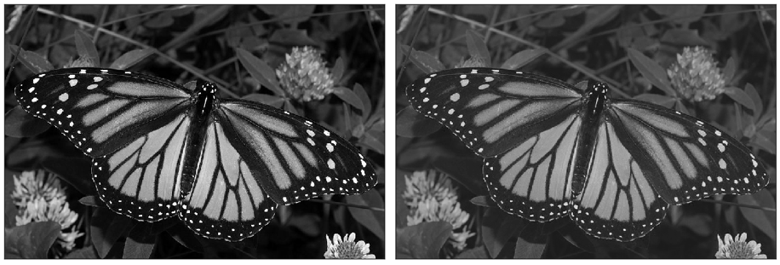
Unsupervised Learning: Dimension Reduction
Use underlying structure of data to represent it more simply
Loses some specificity
Algorithms include PCA, Non-negative Matrix Factorization
Notes:
2

Slide 60
Unsupervised Learning: Dimension Reduction
Applications: image compression, feature engineering, noise reduction
Notes:
2

Slide 61
Machine Learning
Machine Learning
Supervised Learning
Unsupervised Learning
Regression
Classification
Clustering
Dimension Reduction
Demand forecasting
Lifetime value
Churn
Fraud
Customer Segmentation
Feature generation
Image Compression
Feature generation

Slide 62
Machine Learning
Machine Learning
Supervised Learning
Unsupervised Learning
Regression
Classification
Clustering
Dimension Reduction
Demand forecasting
Lifetime value
Churn
Fraud
Customer Segmentation
Feature generation
Image Compression
Feature generation

Slide 63
SPECIAL TOPICS
Notes:
These are just to head off questions down the line. We don’t need to go into any of these details

Slide 64
Special Topics
A/B Testing: running an “experiment” to test two (or more) alternatives against each other
Common in marketing and online sales
Everyday application: button color testing
Notes:
https://hbr.org/2017/06/a-refresher-on-ab-testing

Slide 65

Special Topics
NLP (Natural Language Processing): analysis of human language by computers; machine learning and AI applied to text
E.g. sentiment analysis, topic modelling
Everyday application: autocomplete, chatbot, hiring

Slide 66
Special Topics
Time Series Analysis: applying statistical and machine learning techniques to find patterns in and predict with time-indexed data
Common in financial markets
Everyday application: demand forecasting

Slide 67
Special Topics
Neural Network: a type of machine learning vaguely inspired by the workings of neurons in a brain; composed of an input layer, output layer, and “hidden” layers
Deep Learning: a type of neural net with many hidden layers
Common in image recognition, NLP
Everyday application: speech recognition
Notes:
https://developer.amazon.com/fr/blogs/alexa/post/d70feab5-931f-4f49-a072-4d71435a10f1/alexa-scientists-present-two-new-techniques-to-improve-wake-word-performance

Slide 68
Special Topics
Computer Vision: a field of study on how computers can gain information about an environment through images
Machine learning and neural networks are often applied for image recognition
Everyday application: goofy video filters
Notes:
https://www.businessinsider.com/facebook-vs-snapchat-in-computer-vision-2017-3

Slide 69
Special Topics
Bayesian Statistics: a theory in statistics which takes the approach that probability expresses a “degree of belief”
Results in different assumptions and underlying math
Machine learning methods include naïve Bayes
Notes:
https://hbr.org/2017/06/a-refresher-on-ab-testing

Slide 70
Special Topics
Big Data: extremely large data sets; data that cannot be adequately stored and analyzed on a high- performance personal computer
Not a well-defined term
Term is no longer en vogue
DATA
Notes:
https://hbr.org/2017/06/a-refresher-on-ab-testing

Slide 71
Recap

Slide 72
Learning objectives
Be able to
Describe data science and explain its different facets
Explain the differences between statistics and machine learning
Explain the major branches of machine learning and the types of problems they solve
Describe special topics within data science

Slide 73
Agenda
A Brief History of Data Science
Basics of Data Science
Analytics and Statistics
Statistics and Machine Learning
Machine Learning and Artificial Intelligence
Special Topics
Notes:
2

Slide 74
Takeaways
Data science means different things at different places, but it generally involves, analytics, statistics, machine learning, artificial intelligence, and programming.
Supervised and unsupervised learning are the two main branches of machine learning
Statistics and machine learning have a large overlap
Artificial Intelligence is not well defined
Notes:
2

Slide 75
QUESTIONS?

